Slide 1
Using unsupervised learning to create a book recommendation system
BookBots
UoB data analytics bootcamp

Slide 2




Introduction
Books help us to explore the world in many different ways.
Challenge of finding next book.
Power of new innovative system, data analysis and artificial intelligence.
Introduction to personalized book recommendation system

Slide 3
Data Preparation
Data cleaning: removing any incomplete and duplicated records
Separated multiple authors into individual entries
Calculation of total no of authors and categories
Identifying most frequent authors and categories

Slide 4

Enhancing Book Discoverability through Clustering
Challenges in book discovery.
Information Overload
Diverse Preference
Limited Visibility
Importance of Personalized Recommendation in Improving User Experience
Our Objective: To recommend books based on user preferences and book characteristics.

Slide 5

Why clustering?
It uncovers hidden patterns in book features, aiding in discovering similar titles.
Enables dynamic recommendation without needing explicit user input.
Adaptable and scalable approach for a growing dataset.

Slide 6

Methodology Overview
Data Preparation: Dropping unnecessary columns, one-hot encoding, scaling.
Finding the Best K: use of the Elbow and Silhouette methods for optimal cluster number.
Implementation and Evaluation: Running K-means model, optimising with PCA, and assessing the
model using The Calinski-Harabsz Index.

Slide 7
Model optimisation
Methods Used to Optimise the K-Means Algorithm Model:
Dropped the “authors” column
Filtered the “published year”
Binned the “published year”
Dropped the “categories” column
Eliminated outliers

Slide 8
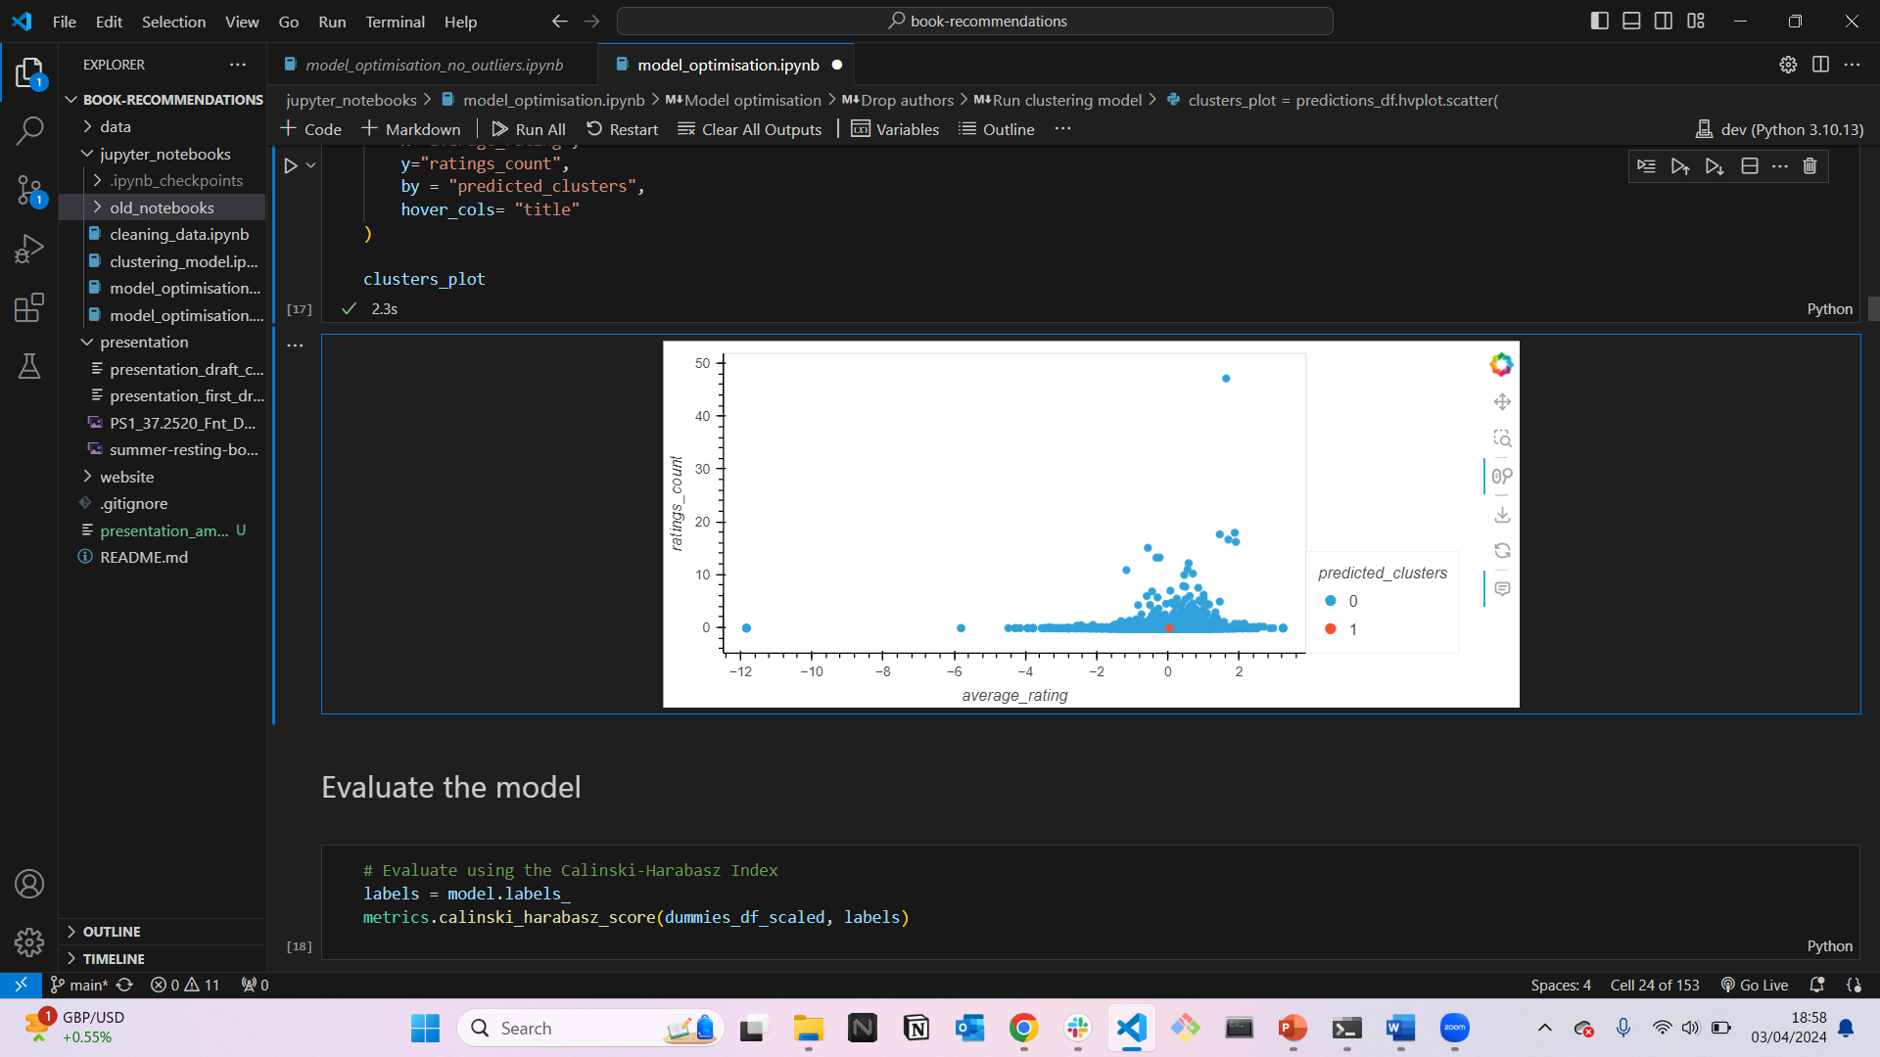
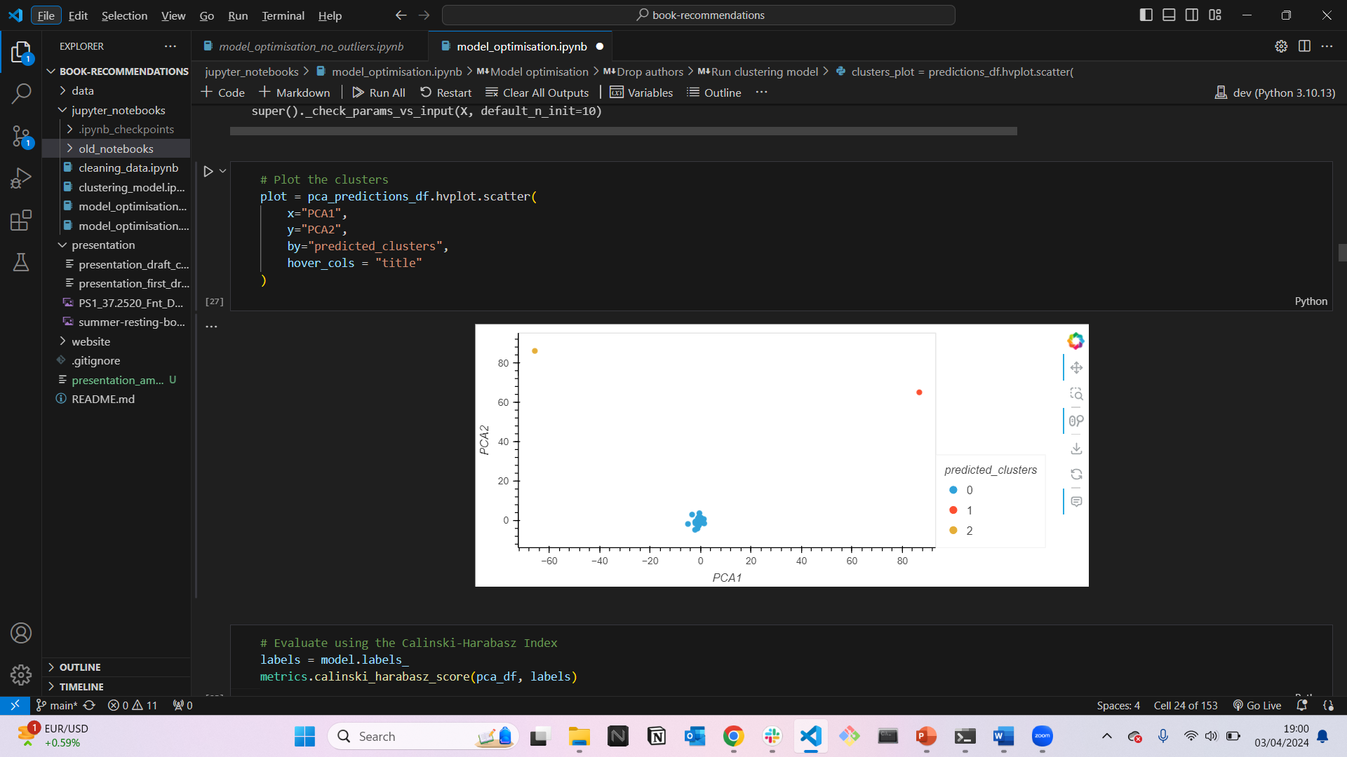
Model optimisation: dropping authors column
Elbow/Silhouette Method:
The silhouette method suggests the optimum k-value is 2
Running a K-means model with 2 clusters results in a Calinski-Harabasz Index score of 20.89.
PCA:
The optimum k-value is 3.
Running the K-means algorithm increases the Calinski-Harabasz Index to 177156.05
Result seems highly determined by 2 outlier books.

Slide 9
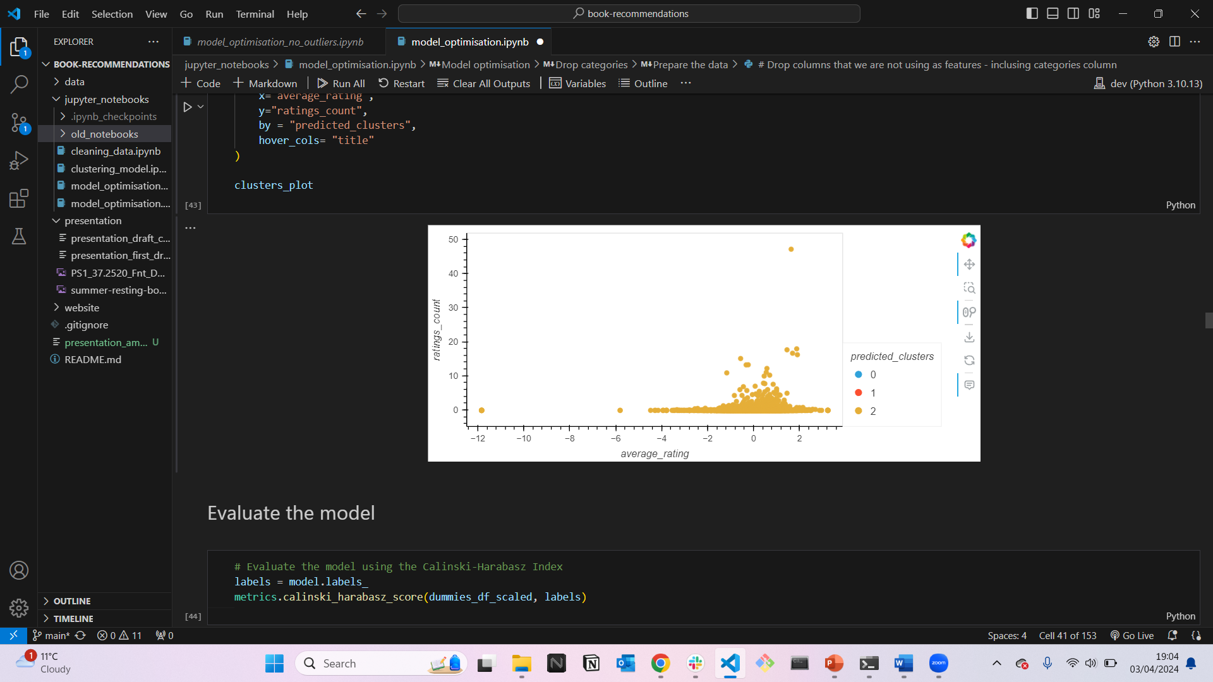
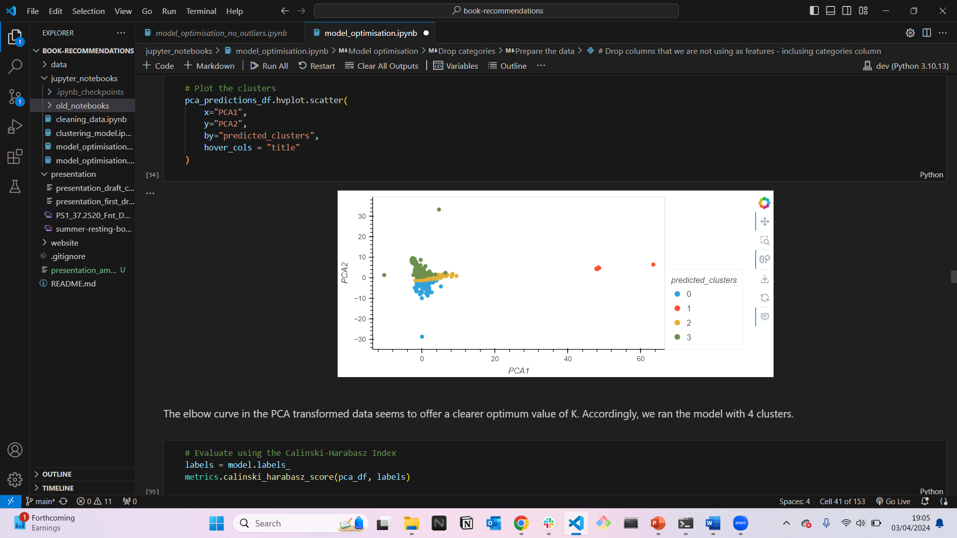
Model optimisation: dropping categories column
Elbow/Silhouette Method:
The silhouette method suggests 3 as the best value for k.
Running a K-means model with 3 clusters resuts in a Calinski-Harabasz Index score of 1.95.
PCA:
The optimum value for k is 4
Running the K-means algorithm increased the Calinski-Harabasz Index to 5600.92.

Slide 10
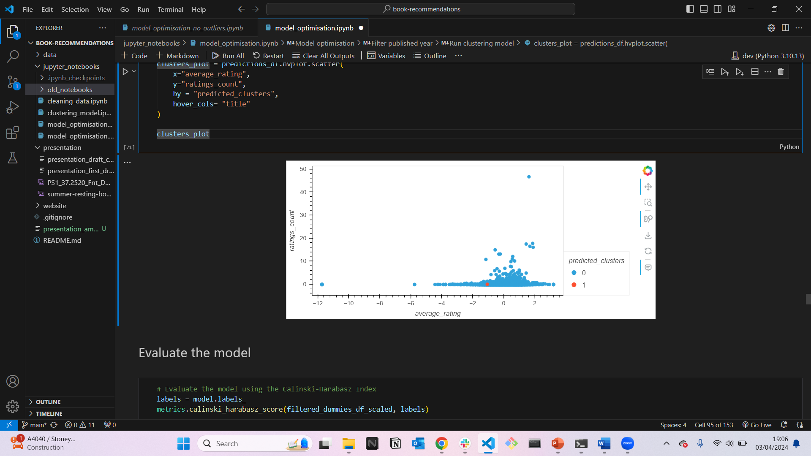
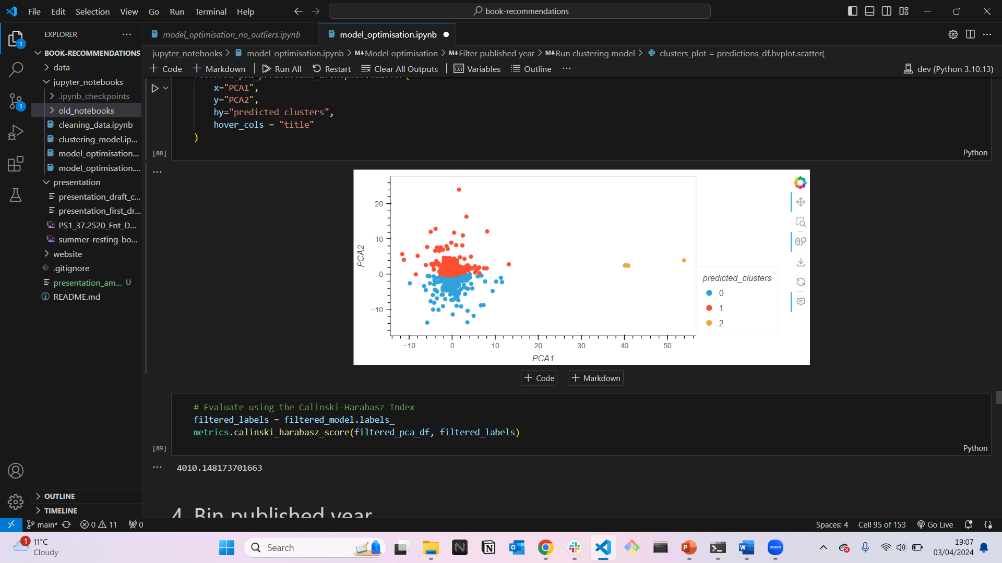
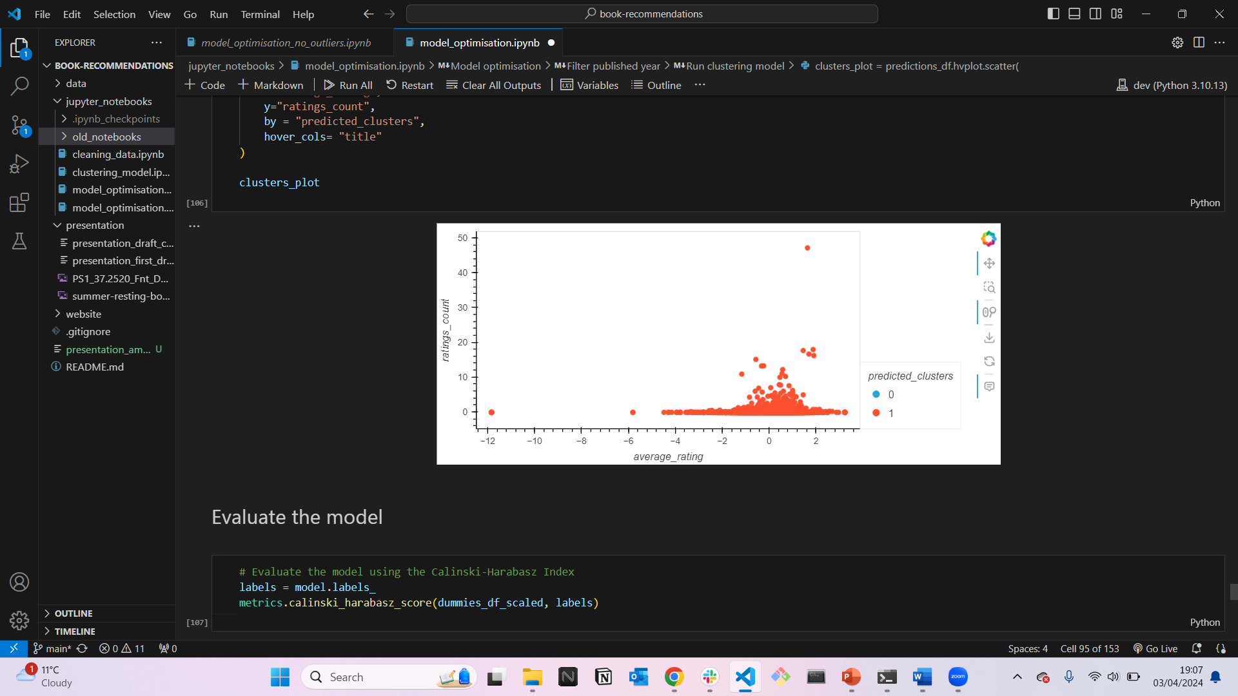
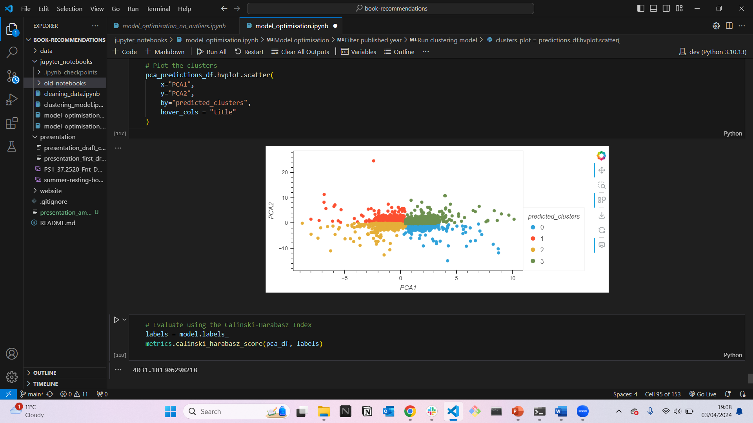
Model optimisation: filtering and binning published year
Elbow/Silhouette Method:
Running a K-means model resulted in a Calinski-Harabasz Index score of 2.95 and 2.35 for the filtered and binned models respectively.
PCA:
Running the K-means algorithm on filtered and binned data resulted in a Calinski-Harabasz Index score of 4010.15 (k=3), and the binned data in a score of 4031.18 (k=4).

Slide 11
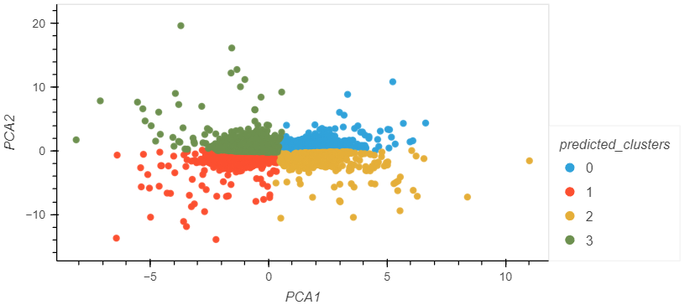
Model optimisation: eliminating outliers
Running the k means algorithm on the pca model gives a Calinski-Harabasz Index of 6247.65
Results not biased by outlier books and clusters are more accurate

Slide 12

Book recommendation website
Software and libraries used:
Created database using SQLite to serve an API
Set up API route to serve the data using Flask
Created book recommendation website using a combination of HTML, CSS and JavaScript
How it works:
User selects a book
JavaScript calculates the 5 closest books (Euclidean distance) in the same cluster, and displays recommendation

Slide 13
Conclusions
Limitations:
Complex dataset (huge number of features after one-hot-encoding)
No data on user interactions and preferences
Does not allow for collaborative filters
BUT
We have built a successful skeleton for a personalized book recommendation system: with just a few tweaks (appropriate data), we believe this could be a very accurate and successful system.

Slide 14
The BookBots team
Ammarah Ahmad
Catarina Ferreira
Kashfi Khalid
Sadek Ahmed
THANK YOU!

